Slide 1




FIRE PROJECT
7he_B0ts

Slide 2
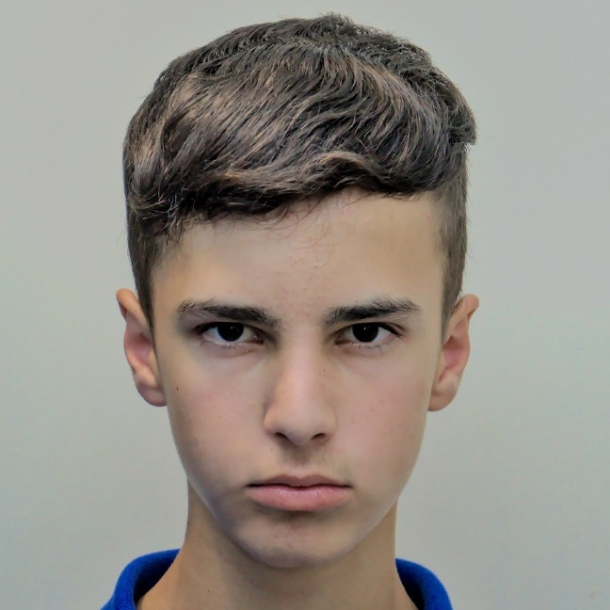



About us:
Yanislav stoyanov zahari bonev ivaylo abadzhiev hristo kovachev

Slide 3



Used functions and tools:

Slide 4

about the project

Slide 5

Thank you for your attention!

